Slide 1

MANGALORE INSTITUTE OF TECHNOLOGY & ENGINEERING
(An ISO 9001:2015 Certified Institution, accredited by NAAC) (A unit of Rajalaxmi Education Trust ®)
Affiliated to V.T.U, Belgaum, Approved by AICTE, New Delhi
NICS Department of Electronics & Communication Engineering & CO
(Accredited by NBA)
PHASE – 1
(Review -2)
PROJECT PRESENTATION
TITLE:-“ABNORMAL HUMAN ACTIVITY ANALYSIS”
Project Associates:
Under the Guidance of :
Mr. Ramalingam H M
Senior Associate Professor, Dept of ECE.
AJAY
DISHU KOTIAN
ELROY SEQUEIRA
USN:4MT19EC004 USN:4MT19EC023 USN:4MT19EC025

Slide 2
Introduction
Today with the growth of nations and the development of digital technologies, it has become easier to solve lot of problems. The new-age technologies like AI/ML, Cloud and edge computing play a huge role in shaping the future.
Computer vision has shown great accomplishments in a wide variety of classification, segmentation and object recognition tasks, but tends to encounter more difficulties when tasks require more contextual assessment.
There are various researches carried out to study human behaviour and identify from their actions. Governments and police departments worldwide are constantly on the lookout for new features that will help prevent crime.
CCTV is just one way they are hoping to improve safety, especially in public spaces. Along with their self-learning systems, features like object tracking, two-way audio and facial recognition make AI CCTV cameras an advanced and effective video security solution.

Slide 3
Problem Statement
With the increase in the amount of anti-social activities taking place in the environment, security has been given the utmost importance lately. Therefore, organizations require a constant monitoring of people and their interactions. Since this constant monitoring of data by humans to judge if the events are abnormal is a near impossible task as it requires a lot of workforce and constant attention.
the challenge that comes up is the demand for an automatic and intelligent analysis for such video sequences. Our project comes forward as an attempt to provide solution to such a problem as the model developed is a smart surveillance system which can detect unusual or abnormal activity automatically.

Slide 4
Literature Review
Sl. No. | Author | year | Journal | Title | Inference
1 | Andrew Joemon, et al., | 2021 | International Journal of Innovative Science and Research Technology | Abnormal Event Detection Using CCTV Camera | With this system, it can automate the process of detecting abnormal events from CCTV camera feeds. CNN and LSTM technologies are used to detect anomalies in both supervised and unsupervised manner. Alert messages can be sent to authorities on detection of events. The design of this system consists of various modules or parts that have to be integrated together to complete the system. This involves the creation of Video Compressor, Anomaly Detector, Storage Management and Alert Management modules.
2 | Arpitha Krishna, et al., | 2021 | IEEE | Advanced Video Surveillance System | In this paper, algorithms are proposed by Sum of Absolute Difference for recording videos only when motion is detected. The major advantage of this algorithm is that less storage is required as the system records only for frames with a particular threshold. Even the amount of processing required is reduced. The system efficiency is calculated to be around 72%.
3 | Mounir Bendali-Braham, et al., | 2021 | IRIMAS | Recent trends in crowd analysis | The deployment of intelligent surveillance systems is linked with the development of smart cities. The use of these systems requires the development of a framework capable of scanning adequately video-surveillance scenes. Throughout this paper, we explored previous reviews on crowd analysis. We saw recent studies pertaining to pedestrian and group detection, as well as on the branches and several sub-branches of crowd analysis. We enumerated the sources of video/image data we came across, and due to the paucity of datasets.

Slide 5
Sl. No. | Author | Year | Journal | Title | Inference
4 | Shabana Habib, et al., | 2021 | ICPSC | Abnormal Activity Recognition from Surveillance Videos Using Convolutional Neural Network | This paper has presented a framework for identifying violent activity in surveillance videos to avoid accidents during Hajj and Umrah. When a violent activity occurs, the system can sound an alarm and notify law enforcement agencies to take the appropriate safety actions required. In order to identify violent activity, we have assessed the performance of our proposed model by using publicly available Hockey Fight and Surveillance Fight datasets. After running multiple experiments, we have achieved 96% accuracy on Hockey Fight and 81.05% on Surveillance Fight datasets, the highest accuracy achieved in comparison with state-of-the-art methods.
5 | CEM DIREKOGLU, et al., | 2020 | IEEE ACCESS | Abnormal Crowd Behavior Detection Using Motion Information Images and Convolutional Neural Networks | It presented an approach for abnormal crowd behavior detection. The proposed approach is based on a new Motion Information Image (MII) model that is formulated using optical flow. The MII depends on the angle difference calculated between the optical flow vectors in consecutive frames. There are also some optical flow measurements that are small, and their angle difference may affect the observation. To overcome this problem, the angle difference is multiplied with the optical flow magnitude in the current frame to generate the MIIs. A convolutional neural network (CNN) is used to learn normal and abnormal events, and when a test sample is input to the CNN, it is assigned to one of the two classes (Normal or Abnormal).
6 | ELVAN DUMAN, et al., | 2019 | IEEE ACCESS | Anomaly Detection in Videos Using Optical Flow and Convolutional Autoencoder | A convolutional autoencoder method is employed to learn the pattern of normal activities in videos. The main idea of the framework is that the frames, which contain any abnormal event, give significantly different motion pattern than the normal frames. As an input to the encoder, dense optical flow maps are used. Then the network is trained with videos in which no abnormal event is included. After the training stage is properly done, the autoencoder can model the complex distribution of the pattern of normal motion changes. If an input video has an abnormal event, the model is expected to give a higher reconstruction error. Besides, the model was able to reconstruct optic flow maps for corresponding normal video volumes. Our framework consists of three main stages. The first stage of the framework, called preprocessing, aims at extracting dense optical flow map of each frame. In the second stage, the convolutional autoencoder is used in order to obtain the spatial structure of each dense optical flow map volume. The last stage includes a convolutional long short-term memory network to learn the temporal patterns of encoded optical flow maps.

Slide 6
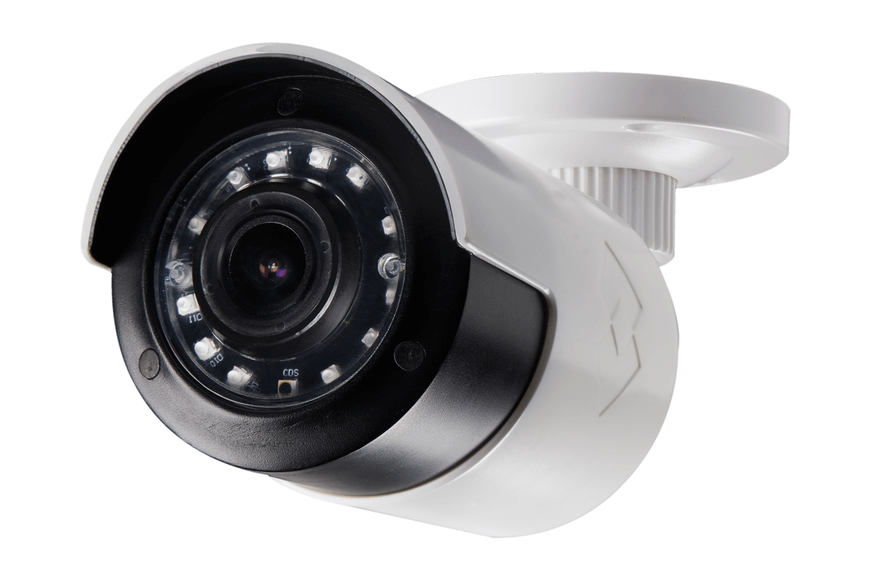
METHODOLOGY
Abnormal activity detection
data
Analysis
No
Violate?
Yes
Alert
notification
Update in dash
board
Continues monitoring
& scaling

Slide 7
Initially, the Sample videos related to abnormal activities are fed in database
The live data is collected from the CCTV camera and it is stored in the database.
Now the sample video and live data from CCTV is compared and analysed for the abnormal activities.
If the abnormal activity is detected then the alert notification is sent or popped up.
If no abnormal activity is found then the system will continue to monitor and will update the process in dash board.
A model was trained using MobileNetV2 using the dataset.
Real-time video footage is given as input.
Output is obtained as image frames.

Slide 8
MobileNet V2
Convolutional neural network that is 53 layers deep
Provides real-time classification capabilities under computing constraints in devices like smartphones.
Utilizes an inverted residual structure where the input and output of the residual blocks are thin bottleneck layers.
Uses lightweight convolutions to filter features in the expansion layer.

Slide 9

HARDWARE/SOFTWARE REQUIREMENTS
+

Slide 10



+

Slide 11
Progress of the work
Gone through different Journals and completed the literature survey.
Started working on training the model for abnormal detection .
Prepared a draft review paper.

Slide 12
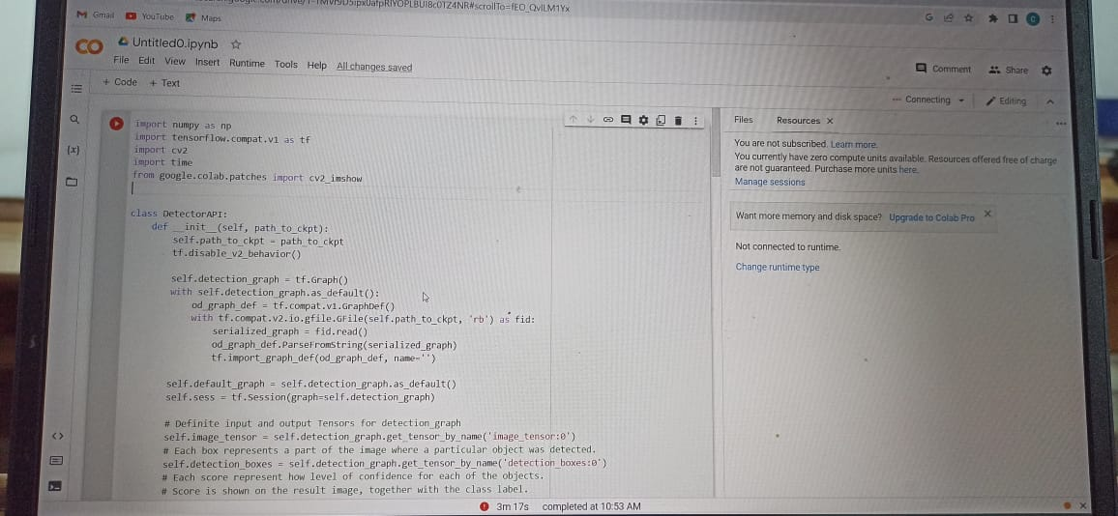
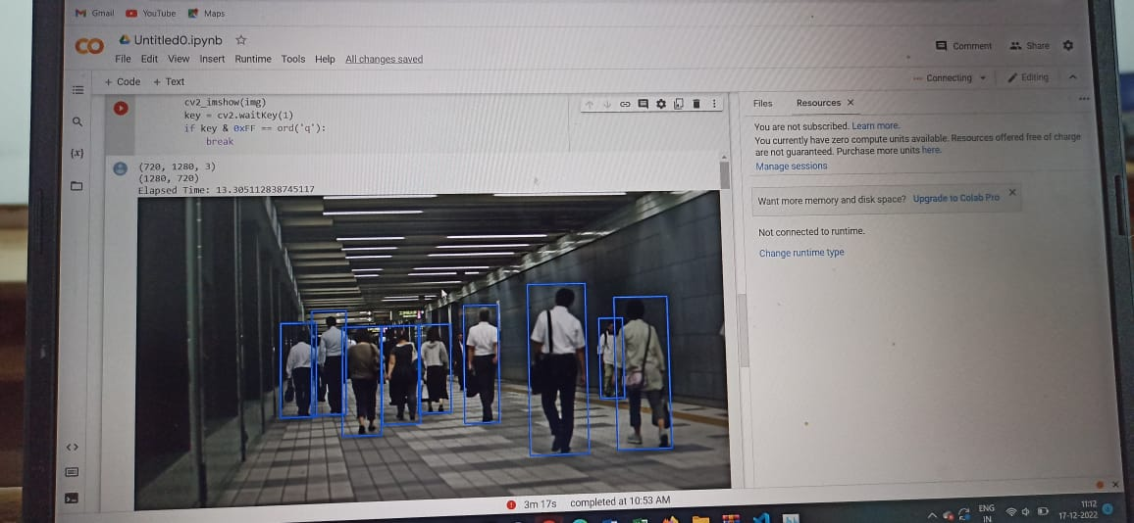

Slide 13
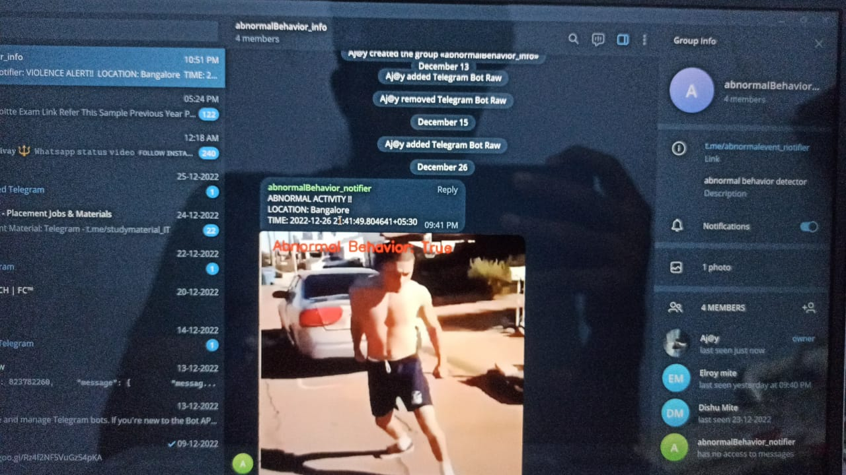

Slide 14
APPLICATIONS
To continuously monitor abnormal behaviour in public places and provide notification to near by authorities.
Used in school/college campus to monitor student behaviour.
Used in shops .
Used in homes.

Slide 15
EXPECTED OUTCOMES
The proposed system will able to detect the abnormal activity found in human.
The system will able to reduce the human violence

Slide 16
REFERENCES
Alam, Md Shahzad, et al. "UAV based cost-effective real-time abnormal event detection using edge computing." Multimedia tools and Applications 78.24 (2019): 35119-35134.
Krishna, Arppitha, et al. "Advanced video surveillance system." 2021 3rd International Conference on Signal Processing and Communication (ICPSC). IEEE, 2021.
Bendali-Braham, Mounir, et al. "Recent trends in crowd analysis: A review." Machine Learning with Applications 4 (2021): 100023.
Habib, Shabana, et al. "Abnormal Activity Recognition from Surveillance Videos Using Convolutional Neural Network." Sensors 21.24 (2021): 8291.
Direkoglu, Cem. "Abnormal crowd behavior detection using motion information images and convolutional neural networks." IEEE Access 8 (2020): 80408-80416.
Duman, Elvan, and Osman Ayhan Erdem. "Anomaly detection in videos using optical flow and convolutional autoencoder." IEEE Access 7 (2019): 183914-183923.
Tripathi, Vikas, et al. "Robust abnormal event recognition via motion and shape analysis at ATM installations." Journal of Electrical and Computer Engineering 2015 (2015).
Adam, Amit, et al. "Robust real-time unusual event detection using multiple fixed-location monitors." IEEE transactions on pattern analysis and machine intelligence 30.3 (2008): 555-560.

Slide 17
Thank you

